Slide 1

CSE 2218: Data Structures and Algorithms II Laboratory
Sherajul Arifin
Lecturer, Department of Computer Science and Engineering,
United International University

Slide 2
Minimum Spanning Tree

Slide 3
Spanning Tree
A spanning tree is a subset of Graph G, which has all the vertices covered with minimum possible number of edges.
Hence, a spanning tree does not have cycles and it cannot be disconnected. By this definition, we can draw a conclusion that every connected and undirected Graph G has at least one spanning tree.
If there are n vertices in the graph, then each spanning tree has n − 1 edges.

Slide 4
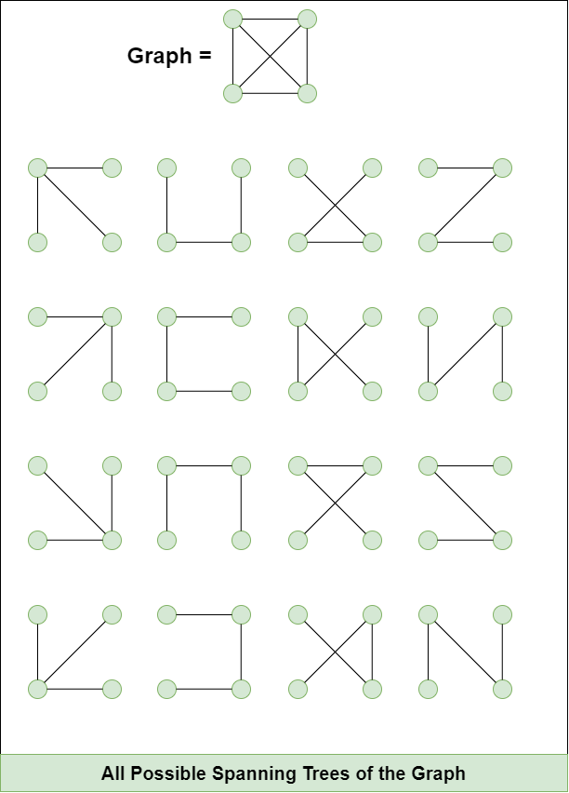

Slide 5
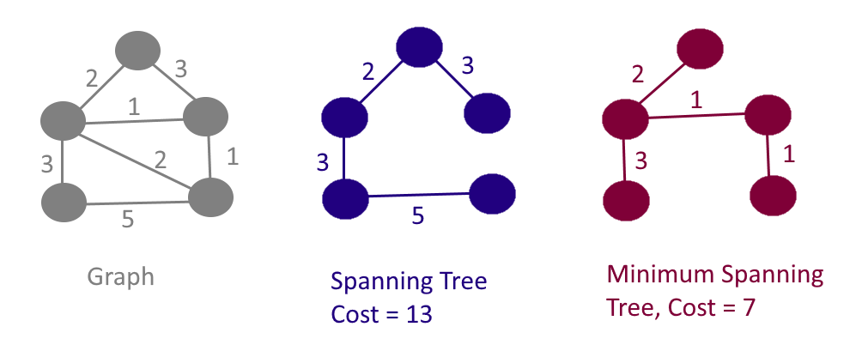
Minimum Spanning Tree

Slide 6
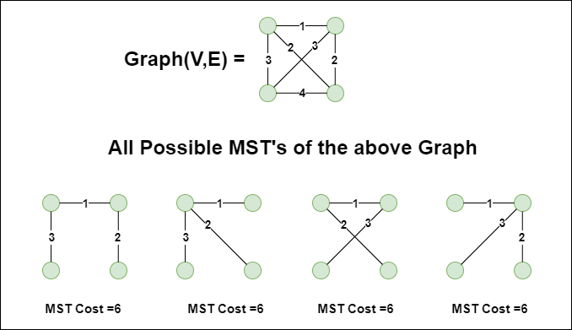
Minimum Spanning Tree

Slide 7
Minimum Spanning Tree
Problem: given a connected, undirected, weighted graph, find a spanning tree using edges that minimize the total weight
6
4
5
9
14
2
10
15
3
8

Slide 8
Prim’s Algorithm
Greedy algorithm like Dijkstra, but instead of shortest path, it picks minimum weight edge to expand MST.
Grows a tree starting from any node.
Steps
Start from a source node, mark it visited.
Push all outgoing edges into a min-heap.
While MST not complete:
  Extract minimum edge (u, v, w).
  If v is not visited, add it to MST and push its edges into heap.
Complexity
Similar to Dijkstra with min-heap.
O(E log V).

Slide 9
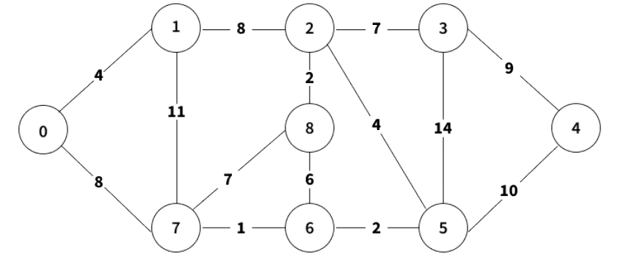

Slide 10
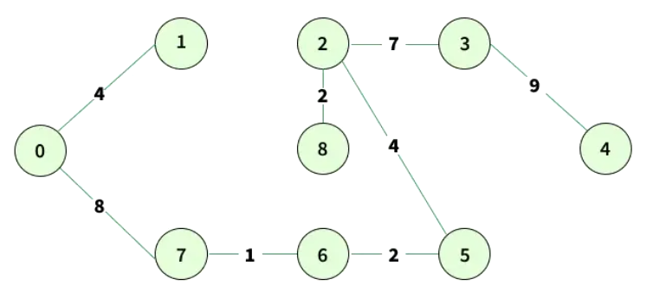

Slide 11
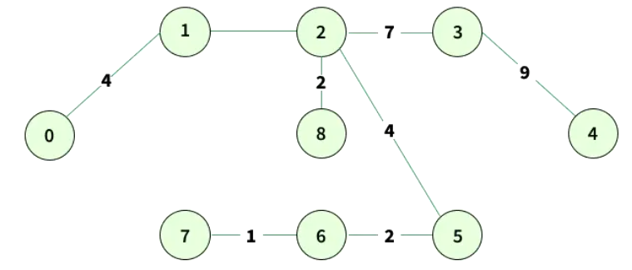

Slide 12
Prim’s Algorithm
MST-Prim(G, w, r)
Q = V[G];
for each u ∈ Q
key[u] = ∞;
key[r] = 0;
p[r] = NULL;
while (Q not empty)
u = ExtractMin(Q);
for each v ∈ Adj[u]
if (v ∈ Q and w(u,v) < key[v])
p[v] = u;
key[v] = w(u,v);

Slide 13
FINDING MST: KRUSKAL’S ALGORITHM
weight | source | dest
1 | 7 | 6
2 | 8 | 2
2 | 6 | 5
4 | 0 | 1
4 | 2 | 5
6 | 8 | 6
7 | 2 | 3
7 | 7 | 8
8 | 0 | 7
8 | 1 | 2
9 | 3 | 4
10 | 5 | 4
11 | 1 | 7
14 | 3 | 5
8
7
1
2
3
4
9
2
0
11
8
4
14
4
7
6
8
10
7
6
5
1
2

Slide 14
weight | source | dest
1 | 7 | 6
2 | 8 | 2
2 | 6 | 5
4 | 0 | 1
4 | 2 | 5
6 | 8 | 6
7 | 2 | 3
7 | 7 | 8
8 | 0 | 7
8 | 1 | 2
9 | 3 | 4
10 | 5 | 4
11 | 1 | 7
14 | 3 | 5
8
7
1
2
3
4
9
2
0
11
8
4
14
4
7
6
8
10
7
6
5
1
2

Slide 15
weight | source | dest
1 | 7 | 6
2 | 8 | 2
2 | 6 | 5
4 | 0 | 1
4 | 2 | 5
6 | 8 | 6
7 | 2 | 3
7 | 7 | 8
8 | 0 | 7
8 | 1 | 2
9 | 3 | 4
10 | 5 | 4
11 | 1 | 7
14 | 3 | 5
8
7
1
2
3
4
9
2
0
11
8
4
14
4
7
6
8
10
7
6
5
1
2

Slide 16
weight | source | dest
1 | 7 | 6
2 | 8 | 2
2 | 6 | 5
4 | 0 | 1
4 | 2 | 5
6 | 8 | 6
7 | 2 | 3
7 | 7 | 8
8 | 0 | 7
8 | 1 | 2
9 | 3 | 4
10 | 5 | 4
11 | 1 | 7
14 | 3 | 5
8
7
1
2
3
4
9
2
0
11
8
4
14
4
7
6
8
10
7
6
5
1
2

Slide 17
weight | source | dest
1 | 7 | 6
2 | 8 | 2
2 | 6 | 5
4 | 0 | 1
4 | 2 | 5
6 | 8 | 6
7 | 2 | 3
7 | 7 | 8
8 | 0 | 7
8 | 1 | 2
9 | 3 | 4
10 | 5 | 4
11 | 1 | 7
14 | 3 | 5
8
7
1
2
3
4
9
2
0
11
8
4
14
4
7
6
8
10
7
6
5
1
2

Slide 18
weight | source | dest
1 | 7 | 6
2 | 8 | 2
2 | 6 | 5
4 | 0 | 1
4 | 2 | 5
6 | 8 | 6
7 | 2 | 3
7 | 7 | 8
8 | 0 | 7
8 | 1 | 2
9 | 3 | 4
10 | 5 | 4
11 | 1 | 7
14 | 3 | 5
8
7
1
2
3
4
9
2
0
11
8
4
14
4
7
6
8
10
7
6
5
1
2

Slide 19
weight | source | dest
1 | 7 | 6
2 | 8 | 2
2 | 6 | 5
4 | 0 | 1
4 | 2 | 5
6 | 8 | 6
7 | 2 | 3
7 | 7 | 8
8 | 0 | 7
8 | 1 | 2
9 | 3 | 4
10 | 5 | 4
11 | 1 | 7
14 | 3 | 5
8
7
1
2
3
4
9
2
0
11
8
4
14
4
7
6
8
10
7
6
5
1
2

Slide 20
weight | source | dest
1 | 7 | 6
2 | 8 | 2
2 | 6 | 5
4 | 0 | 1
4 | 2 | 5
6 | 8 | 6
7 | 2 | 3
7 | 7 | 8
8 | 0 | 7
8 | 1 | 2
9 | 3 | 4
10 | 5 | 4
11 | 1 | 7
14 | 3 | 5
8
7
1
2
3
4
9
2
0
11
8
4
14
4
7
6
8
10
7
6
5
1
2

Slide 21
weight | source | dest
1 | 7 | 6
2 | 8 | 2
2 | 6 | 5
4 | 0 | 1
4 | 2 | 5
6 | 8 | 6
7 | 2 | 3
7 | 7 | 8
8 | 0 | 7
8 | 1 | 2
9 | 3 | 4
10 | 5 | 4
11 | 1 | 7
14 | 3 | 5
8
7
1
2
3
4
9
2
0
11
8
4
14
4
7
8
10
7
6
5
1
2

Slide 22
weight | source | dest
1 | 7 | 6
2 | 8 | 2
2 | 6 | 5
4 | 0 | 1
4 | 2 | 5
6 | 8 | 6
7 | 2 | 3
7 | 7 | 8
8 | 0 | 7
8 | 1 | 2
9 | 3 | 4
10 | 5 | 4
11 | 1 | 7
14 | 3 | 5
8
7
1
2
3
4
9
2
0
11
8
4
14
4
7
8
10
7
6
5
1
2

Slide 23
weight | source | dest
1 | 7 | 6
2 | 8 | 2
2 | 6 | 5
4 | 0 | 1
4 | 2 | 5
6 | 8 | 6
7 | 2 | 3
7 | 7 | 8
8 | 0 | 7
8 | 1 | 2
9 | 3 | 4
10 | 5 | 4
11 | 1 | 7
14 | 3 | 5
8
7
1
2
3
4
9
2
0
11
8
4
14
4
7
8
10
7
6
5
1
2

Slide 24
weight | source | dest
1 | 7 | 6
2 | 8 | 2
2 | 6 | 5
4 | 0 | 1
4 | 2 | 5
6 | 8 | 6
7 | 2 | 3
7 | 7 | 8
8 | 0 | 7
8 | 1 | 2
9 | 3 | 4
10 | 5 | 4
11 | 1 | 7
14 | 3 | 5
8
7
1
2
3
4
9
2
0
11
8
4
14
4
8
10
7
6
5
1
2

Slide 25
weight | source | dest
1 | 7 | 6
2 | 8 | 2
2 | 6 | 5
4 | 0 | 1
4 | 2 | 5
6 | 8 | 6
7 | 2 | 3
7 | 7 | 8
8 | 0 | 7
8 | 1 | 2
9 | 3 | 4
10 | 5 | 4
11 | 1 | 7
14 | 3 | 5
8
7
1
2
3
4
9
2
0
11
8
4
14
4
8
10
7
6
5
1
2

Slide 26
weight | source | dest
1 | 7 | 6
2 | 8 | 2
2 | 6 | 5
4 | 0 | 1
4 | 2 | 5
6 | 8 | 6
7 | 2 | 3
7 | 7 | 8
8 | 0 | 7
8 | 1 | 2
9 | 3 | 4
10 | 5 | 4
11 | 1 | 7
14 | 3 | 5
7
1
2
3
4
9
2
0
11
8
4
14
4
8
10
7
6
5
1
2

Slide 27
weight | source | dest
1 | 7 | 6
2 | 8 | 2
2 | 6 | 5
4 | 0 | 1
4 | 2 | 5
6 | 8 | 6
7 | 2 | 3
7 | 7 | 8
8 | 0 | 7
8 | 1 | 2
9 | 3 | 4
10 | 5 | 4
11 | 1 | 7
14 | 3 | 5
7
1
2
3
4
9
2
0
11
8
4
14
4
8
10
7
6
5
1
2

Slide 28
weight | source | dest
1 | 7 | 6
2 | 8 | 2
2 | 6 | 5
4 | 0 | 1
4 | 2 | 5
6 | 8 | 6
7 | 2 | 3
7 | 7 | 8
8 | 0 | 7
8 | 1 | 2
9 | 3 | 4
10 | 5 | 4
11 | 1 | 7
14 | 3 | 5
7
1
2
3
4
9
2
0
8
4
4
8
7
6
5
1
2
MST with cost = 37

Slide 29
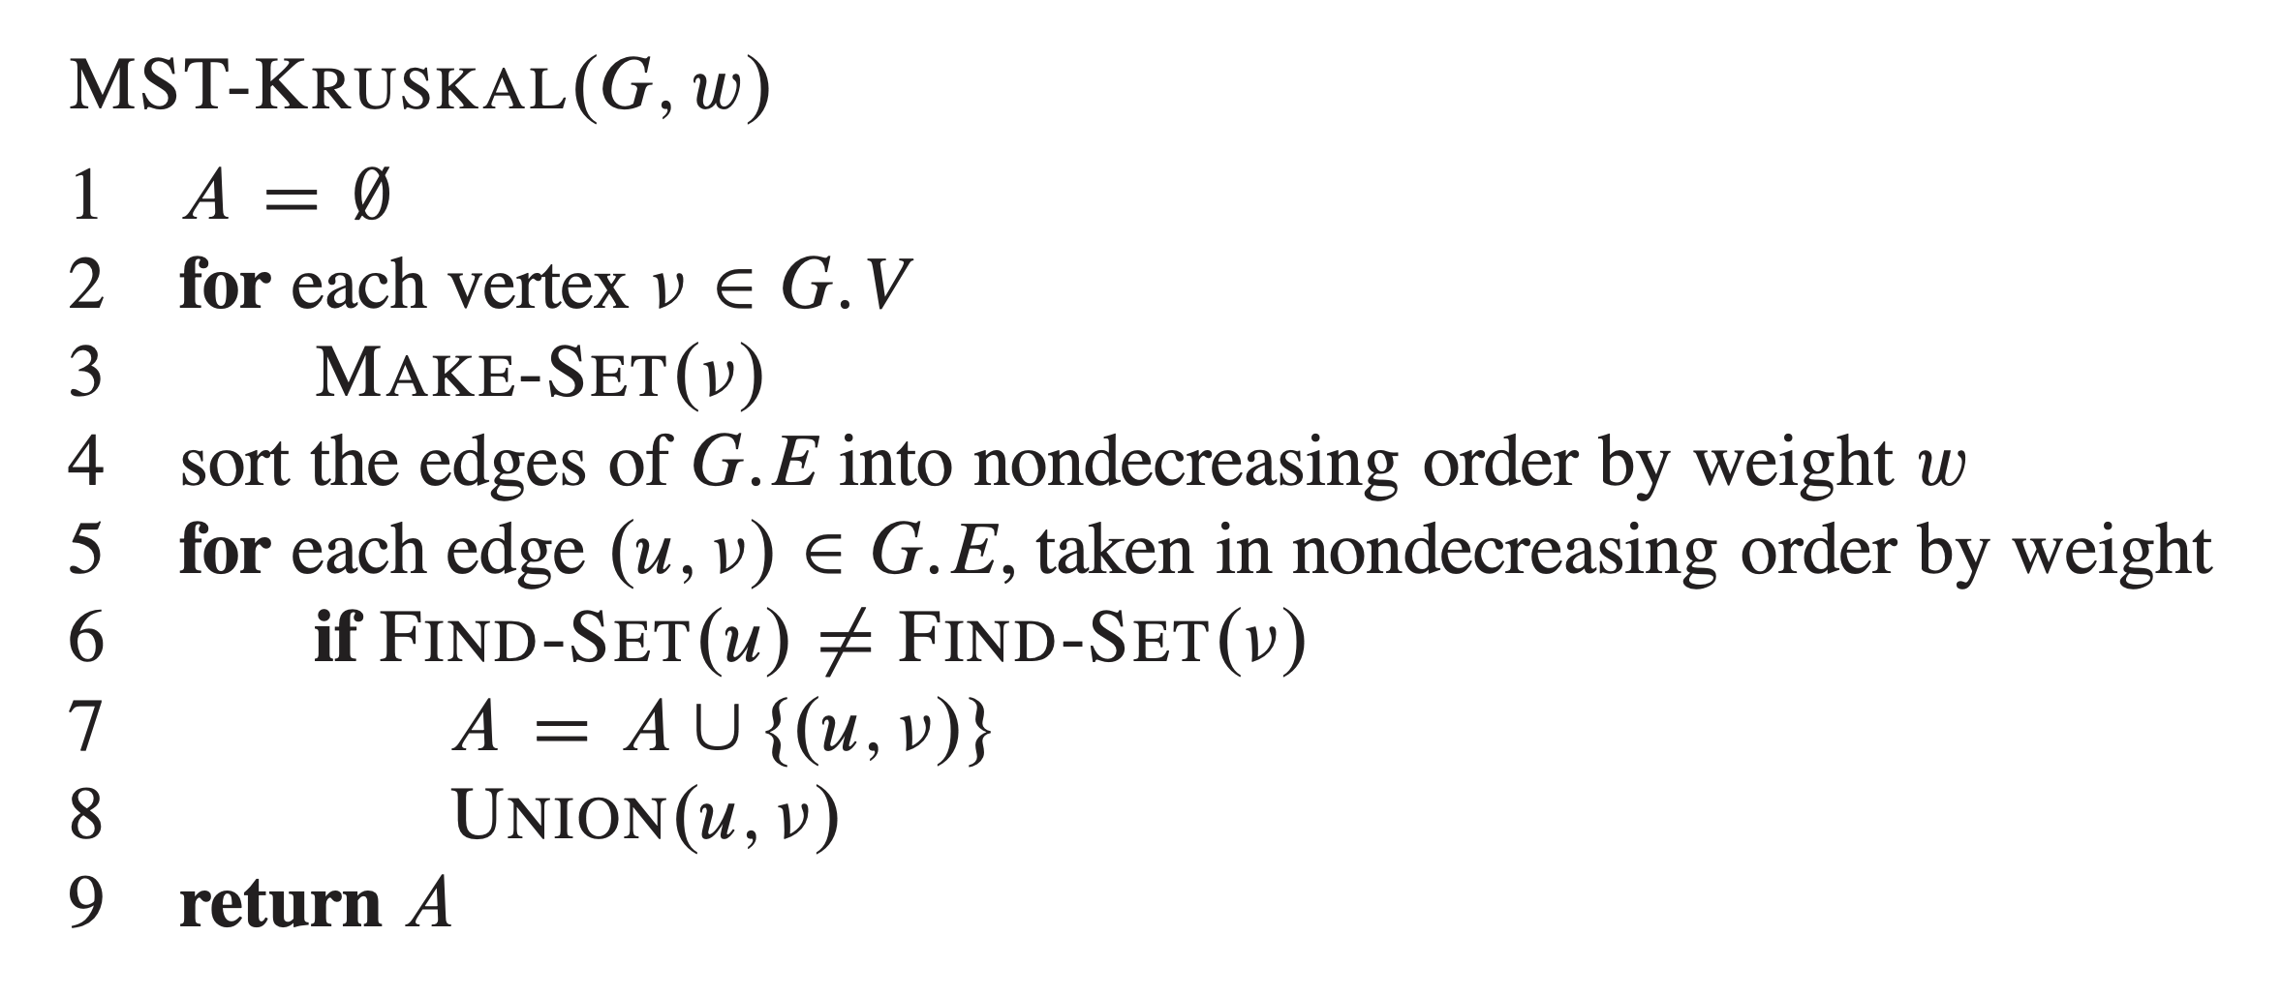
FINDING MST: KRUSKAL’S ALGORITHM
8
7
1
2
3
4
9
2
0
11
8
4
14
4
7
6
8
10
7
6
5
1
2

Slide 30
Any Questions?

Slide 31
Thank You!

